Slide 1
Aim #1
Engage community
Highlight existing:
modeling efforts
strategic datasets
Aim #2
Define and bootstrap an inclusive community-driven model and data-integration process
Open pre-competitive reference models of hippocampus CA1
Documented, validated, and alive
Notes:
Welcome
High profile speakers, encouraging remarks
Struck a chord?
This meeting is about community models
Who has to leave early on Wednesday ?
Leading up to meeting
I’ve waiting 5 years for this meeting
FACETS: Can’t collaborate because we don’t have the tools
30 labs, same order effects,
In desparation, joined controversial BBP project, becaused the seemed to have many people working on one model
Massivly collaborative
3 approaches to community models: don’t, adhoc, coordinated push
Levels of detail: simplfied, data-driven
False dichotomy
Systematic simplificaiton
Why community models?
Releases
BBP Workflow

Slide 2
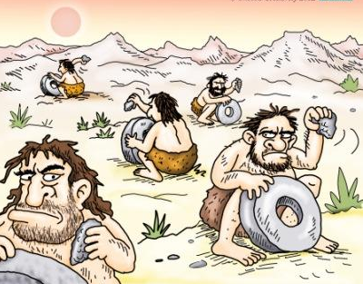

Slide 3
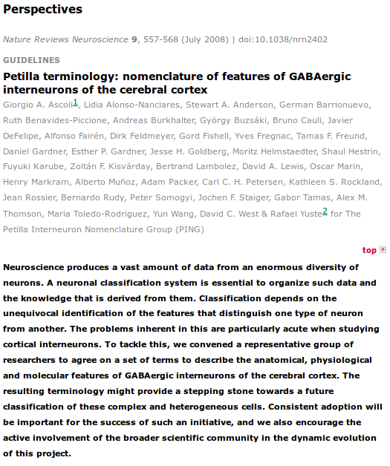
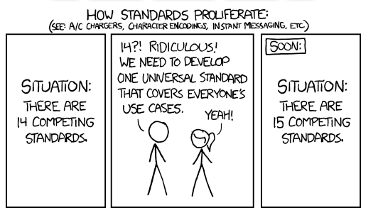

Slide 4
Community Models

Slide 5
Old argument We can’t collaborate because we don’t have the tools!

Slide 6
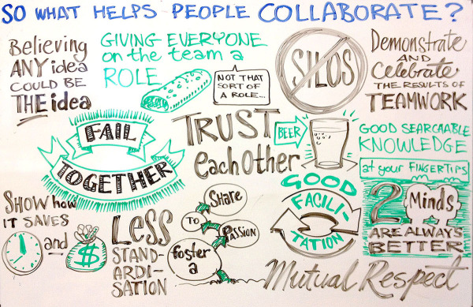

Slide 7
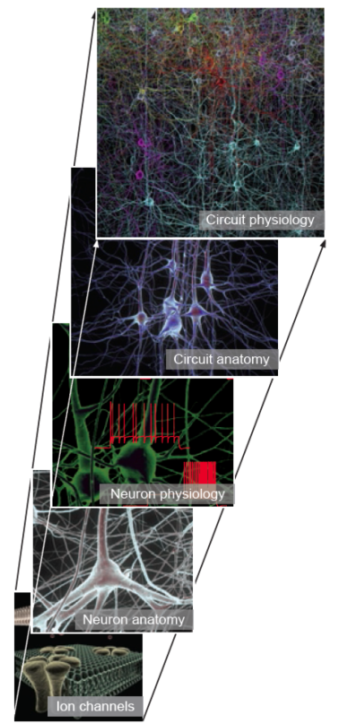
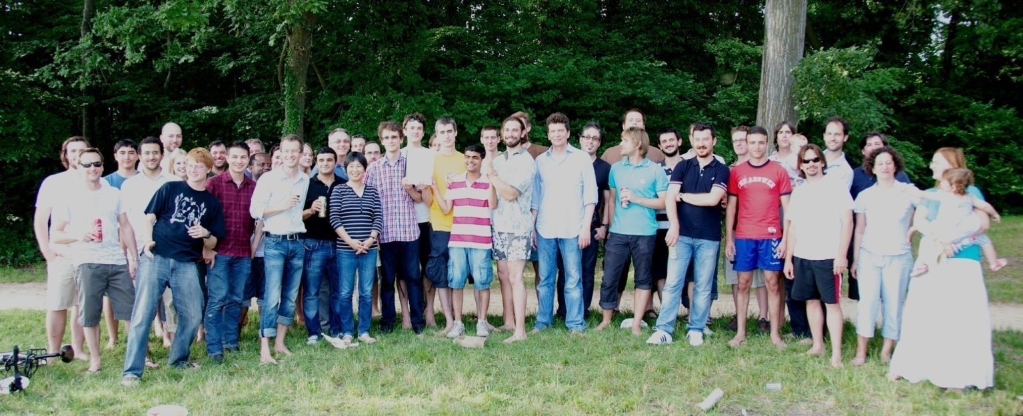
Microcircuit – Somatosensory Cortex
Sparse
Data
Algorithms
Principles
“Massively Collaborative Modeling”
Multi-level validation
Submitted & in review: Markram et. al., “Reconstruction and simulation of neocortical microcircuitry”; Collaborative science: 73 authors.
Notes:
Markram et. al., “Reconstruction and simulation of neocortical microcircuitry”; Collaborative science: 73 authors.
Comprehensive description of data-driven reconstruction of neural tissue from sparse data. Levels covered: ion-channels to network physiology.
“Microcircuit & Cellular levels” – based on background work done in Blue Brain Project over last 10 years.
Multi-level validation was observed to prevent overfitting at anyone level
Drove discovery of fundamental role played by Calcium levels in determining spontaneous and evoked network dynamics.

Slide 8
Why now?
HBP roadmap to deliver models of neocortex, hippocampus, cerebellum of similar detail to BBP cortical column model (April 2016)
CA1 Model by Sept 2015 (Armando will show how it will look without community contribution)
HBP mandate for open, collaborative tools
Be inclusive, non-competitive with work of community of experts
Avoid yet another model
Models by community for community

Slide 9
Points of contention
Time-scale of community initiative
Community approach to follow
Don’t (business as usual)
Adhoc (ModelDB, etc.)
Coordinated push (OpenWorm is example?)
Level of detail
Data-driven in silico Neuroscience
Abstract models

Slide 10
Level of detail - False Dichotomy
Integrate new data in models @ level of data
Data-driven is data-ready
Necessary but not sufficient:
Automated & principled & repeatable & quantifiable simplification
… of data-driven reference

Slide 11
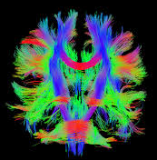
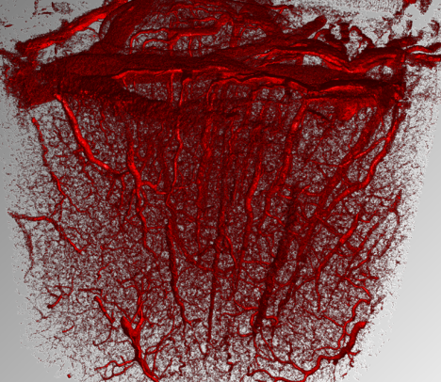
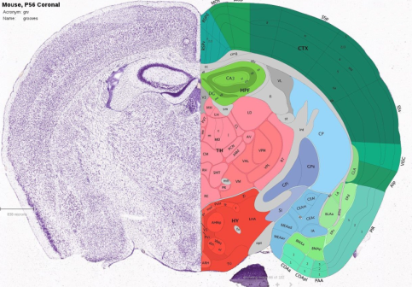
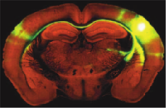
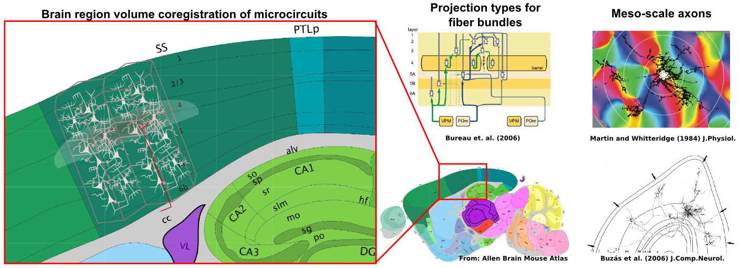
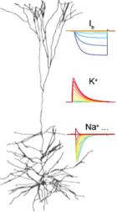
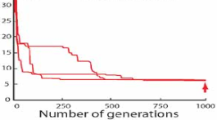
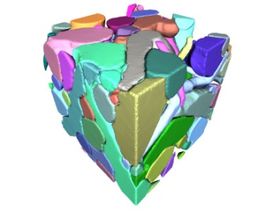
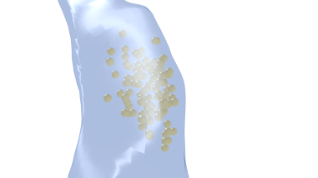
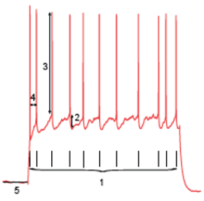
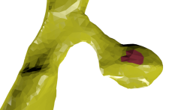
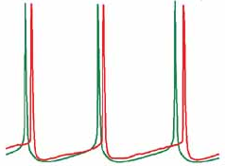
Multiple scales of
data integration
Cells
Fibers
Vasculature
Macro-scale
(whole brain)
Meso-scale
(regions & areas)
Microcircuit
(unitary network)
Cellular
Optimization
Sub-cellular
Notes:
D6.7.1 defines the minimal parameterization and validation datasets to be integrated at each level

Slide 12
Agenda
Sessions by domains/levels, bottom-up
Neurons & Synapses
Microcircuit
Large-scale datasets
Discussion/Crowd-source
State-of-the-art data, models
Summary of minimal validations for comment & review
Transparent (live) note taking
Community convergence (30mins)
Position statements (2 slides, 5 mins max)

Slide 13
My Ideal Outcomes
Consensus on a community approach to follow
Take first steps to realization
Opinion paper:
1/3 discussion of issues, approaches, motivation
1/3 summary parameterization & validation datasets, modeling state-of-art
1/3 implementation, roadmap, dissemination strategy
Trigger other similar initiatives …
What are yours?

Slide 14
Community Models
A beginning …

